Slide 1
First Battle of the Bull Run
Name of student
Date

Slide 2
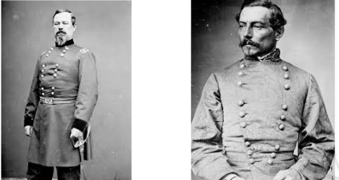
When ? Where ?Who were the adversaries ?
The first battle of the bull run occurred on July 16-21, 1861.
It occurred at Prince William County, Virginia
It was the first major battle of the American Civil War. Union troops led by Brigadier General Irvin McDowell from federal capital in Washington D.C. to strike Confederate troops, led by General P.G.T. Beauregard, along a small river known as Bull Run

Slide 3
Strategic operational overview
The first battle of the Bull Run was fought at a small stream and tributary of the Potomac River known as Bull Run near Manassas in Northern Virginia. It was a chaotic encounter fought by volunteers short of training and organization and haphazardly equipped. It ended in victory for the Confederates under General Pierre Beauregard.

Slide 4
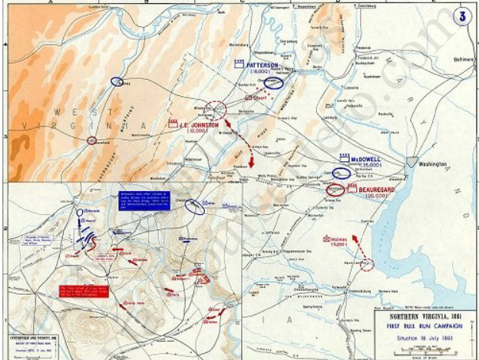
The campaign
According to the campaign map, the soldiers moved around before and during the war. The plan of McDowell's was to move westward in three columns and make a diversionary attack on the Confederate line at Bull Run with two columns. While the third column moved around the Confederates' right flank to the south, cutting the railroad to Richmond. His assumptions was that the Confederates would be forced to abandon the junction of Manassas and fall back to the Rappahannock River. McDowell had hoped to have his army at Centreville by 17 July but the troops, unaccustomed to marching moved very slow. Along the route soldiers often broke ranks to wander to get food or water.

Slide 5
Area Operations
The weather was very hot and unfit for the soldiers .The soldiers arrived at the Bull Run exhausted from the Washington march. Despite the challenges ,the battle opened to their advantage
The terrain of the battlefield included vegetation ,drainage ,houses ,hills and roads.
The Henry House hill held back Confederate Coloniel Thomas Jackson to the union troops. He held the hill as a stone wall which earned him stonewall nickname.

Slide 6
Principle antagonists
35,000 Union troops sent
20,000 Confederate troops
Some technology advances that were used in the battle include the battle supremacy on the waters.
The mission of the battle was to have the main share of the land which resulted to a land battle.

Slide 7
Action Description
The first battle of Bull Run also known as Manassas was the first major battle in the civil war .on July 21,1861 ,confederate and union armies clashed in Virginia near Manassas Junction .The engagement started when 35,000 union troop marched against 20,000 confederate force along River Bull Run.
Confederates won after fighting on defence for most of the day, when rebels rallied and were able to send the federals into a chaotic retreat towards Washington.
the victory of the confederate gave confidence to the South and many were shocked by realizing the war was not as easy as they thought.
460 Unions died, 1124 wounded,1312 went missing
387 Confederates died, 1582 wounded,13missing

Slide 8
Action significance
Through the Bull Run experience we learn the fact that every time a nation plan to go for a war ,it should learn that wars are easy to start than to stop. And the wars usually stops when one of the is unable to compete further or completely destroyed.
We also learn not to give up easily in this case we can see both the battles were determined to win and none of them was ready to end the war.
There was an early indication that it was easy to counter attack and defend than launching an initial attack.

